Slide 1

RISC-V implementation on FPGA
Group Project
ES 299

Slide 2


PROJECT PRESENTATION
Jadhav Anvesh
Boda Sandeep
Sumedh Wankhede
Prof. Joycee Mekie

Slide 3




Project vision and mission
Understand the internal working of processor pipelines.
Demonstrate real-time instruction execution.
Validate custom RISC-V designs in hardware.
This project focuses on the design and implementation of a RISC-V processor architecture on a Field Programmable Gate Array (FPGA).
RISC-V is an open-source Instruction Set Architecture (ISA) known for its simplicity, flexibility, and extensibility, making it ideal for academic, research, and industry applications.
Explore performance, flexibility, and reconfigurability advantages of FPGA platforms.

Slide 4

Top Module (matrix multiplication)
clk
This top module brings together the matrix multiplier and the UART transfer unit, sharing one block RAM for both the calculation stage and the data‐sending stage.
start – Begins the matrix-multiplication pipeline
transfer_start – Begins serial transmission of results over UART
transfer_reset – Resets the UART transmitter logic (used after each frame)
busy – High while matrix multiply is in progress
done – High one cycle when computation completes
TxD – UART serial data output to FPGA pin
rst
Image Done
start
top_matrix_bram
TxD
transfer_start
done
transfer_reset

Slide 5
Matrix Mutliplier Module
Performs tiled matrix multiplication using on‐chip BRAM for data storage and accumulation.
Inputs:
clk, rst – Clock and synchronous reset
start – Begin the multiplication process
a_base, b_base, c_base – Base addresses in BRAM for matrices A, B, and output C
Outputs & BRAM Controls:
busy – High while multiply is running
done – Pulses high for one cycle when C is fully written
bram_en – Enables BRAM access (read or write)
bram_we – Selects write (1) or read (0) mode
bram_addr – Address in BRAM for the current element
bram_din – Data to write into BRAM
bram_dout – Data read from BRAM (fed into the FSM)
clk
busy
rst
done
start
matrix_multiplier
bram_en
bram_we
[7:0] a_base
bram_addr
[7:0] b_base
bram_din
[7:0] c_base
[31:0] bram_dout

Slide 6
BRAM Module
This module wraps around Xilinx’s Block Memory Generator IP to provide a simple interface for reading and writing data from a single-port block RAM.
Inputs:
clk – Clock signal
en – Enable signal for the memory
ren – Read enable
wen – Write enable
addr[16:0] – Address line for accessing memory
din[7:0] – Data input (for write operations)
Output:
dout[7:0] – Data output (from read operations)
wen
clk
addr[16:0]
en
BRAM
[31:0] dout
ren
[31:0] din

Slide 7
Uart Module
This module reads bytes from BRAM and sends them out serially over UART.
Inputs:
clk – UART clock
reset – Synchronous reset for the UART state machine
transmit – Starts a new byte transfer when high
dout_tx[7:0]– Data byte read from BRAM
Outputs & Control Signals:
TxD – UART serial data output (idle high, start bit = 0, stop bit = 1)
ea_tx – Always high to enable BRAM read port
addr_tx[16:0]– Current BRAM address being read
din_tx[7:0] – Always 0 (unused write data)
clk
TxD
reset
[9:0]addr_tx
uart
transmit
ea_tx
[7:0]dout_tx
[31:0]din_tx
[31:0]dout_tx

Slide 8
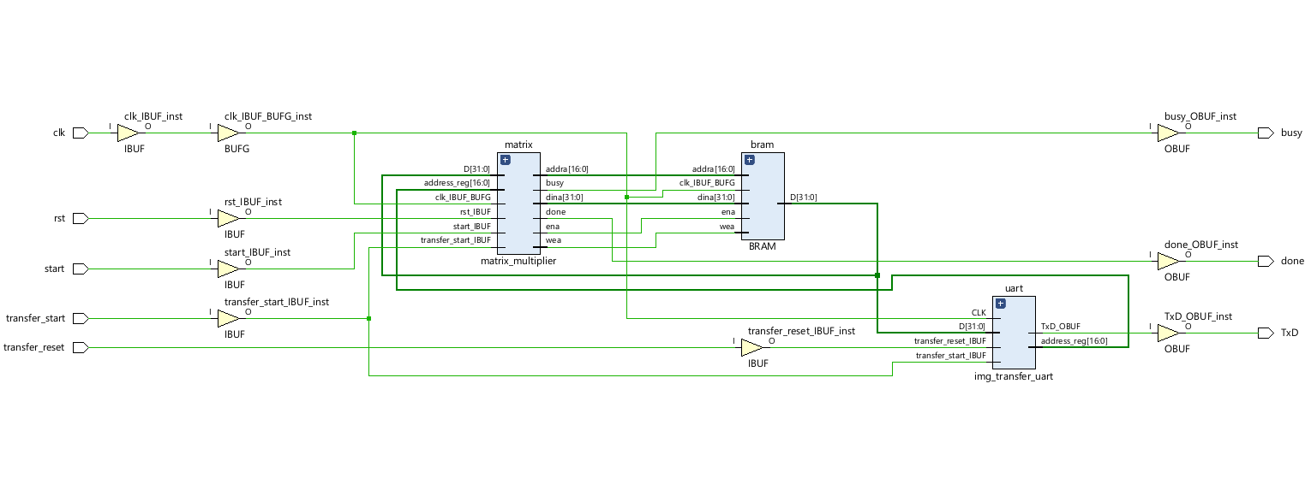
Top Module

Slide 9
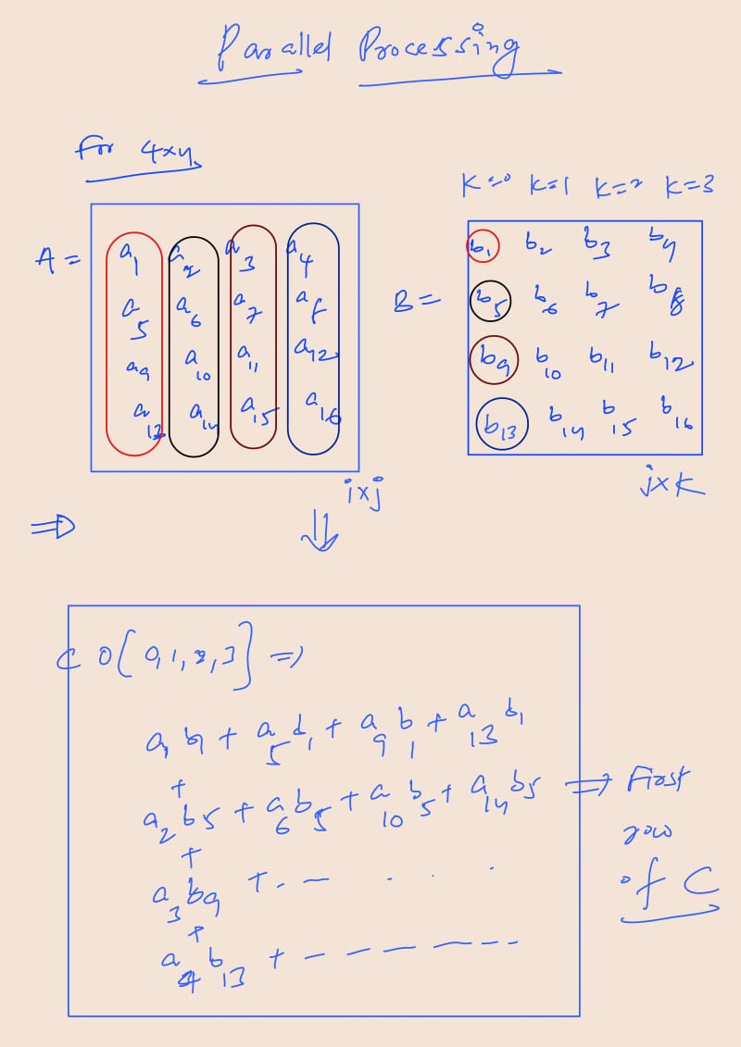
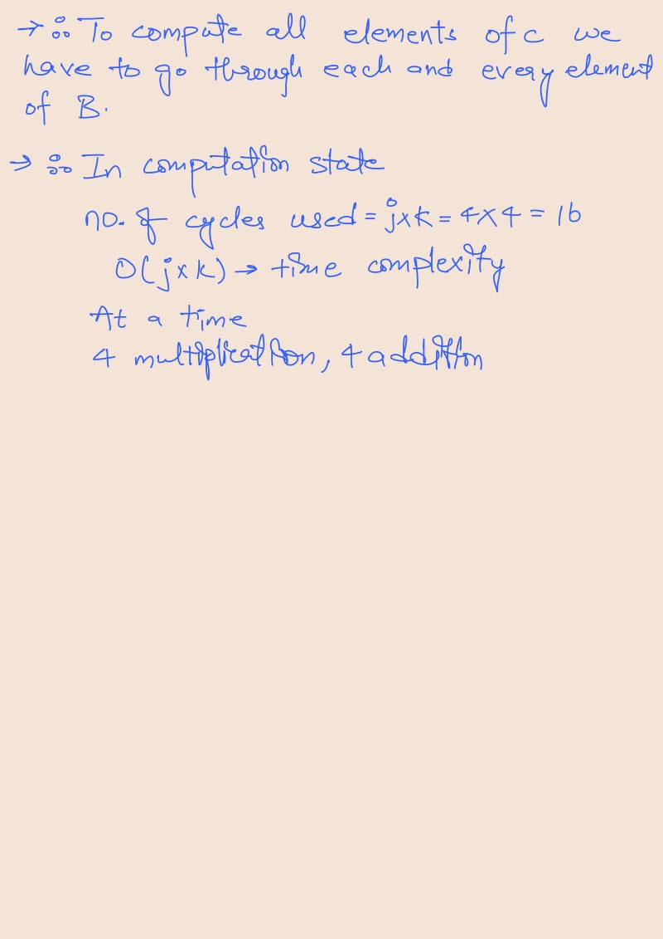
DGEMM using parallel.

Slide 10
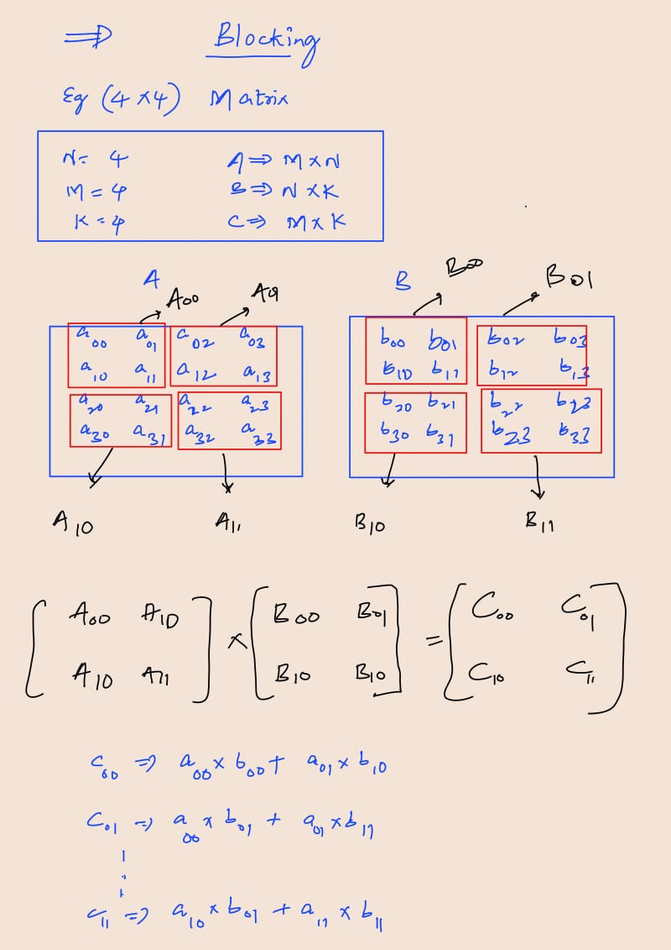
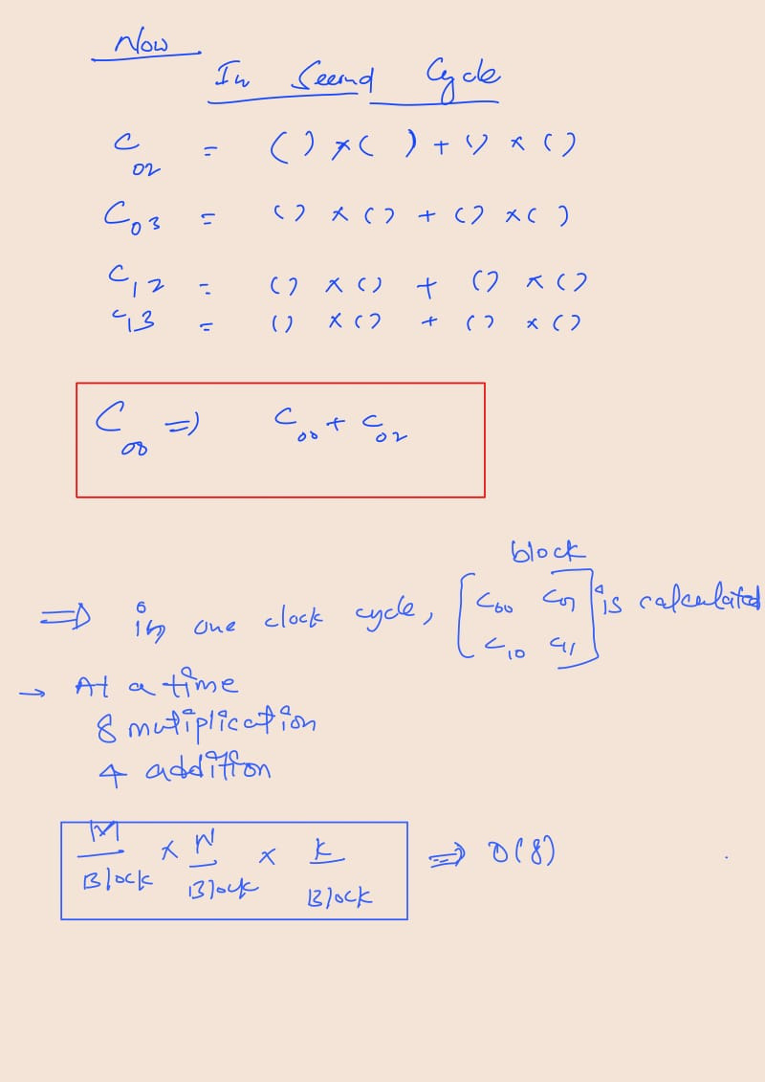
DGEMM using blocking.

Slide 11
ISA: It's like a guide that shows how software interacts with hardware. It lists all the instructions a computer can understand.
RISC-V is an ISA, and most ISA are similar in structure, although they are different in syntax
.
Some popular Instruction sets:
RISC-V
MIPS
Intelx86
RISC-V uses three operands per instruction. (eg. add a, b, c . The sum of b and c is placed in a)

Slide 12
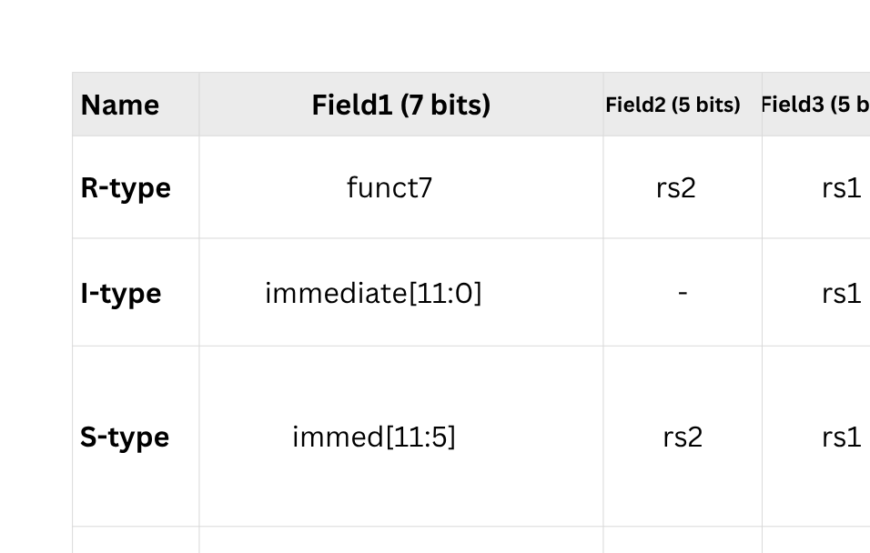
RISC-V Instruction Formats

Slide 13
How is machine code decoded
30'd 7 : data = 32'h00312023 ; // sw x3, 0(x2)
S-Type Instruction
32 bit binary = 0000 0000 0011 0001 0010 0000 0010 0011₂
S-type (stores) opcode
0000000 00011 00010 010 00000 0100011
imm[11:5]
rs2
rs1
funct3
imm[4:0]
opcode
lower 5 bits of 12-bit immediate
source register (data to store)
upper 7 bits of 12-bit immediate
“store word” width selector
base register (address pointer)

Slide 14
Assembly code for sorting array
30'd 3 : data = 32'h00000113 ; // addi x2,x0,0
30'd 4 : data = 32'h00000193 ; // addi x3, x0, 0 i
30'd 5 : data = 32'h00100213 ; // addi x4, x0, 0 j
30'd 6 : data = 32'h02400313 ; // addi x6, x0, 36 n
30'd 7 : data = 32'h00000413 ; // addi x8, x0, 0
30'd 8 : data = 32'h00000493 ; // addi x9, x0, 0
30'd 9 : data = 32'h0a61d263 ; //bge x3,x6,164=(50-9)*4->end of program
30'd 11 : data = 32'h04625863 ; //bge x4,x6,80=(31-11)*4
30'd 14 : data = 32'h00012403 ; // lw x8,0(x2)
30'd 18 : data = 32'h00420213 ; // addi x4, x4, 4
30'd 19 : data = 32'h00412483 ; // lw x9,4(x2)
30'd 23 : data = 32'h0084da63 ; //bge x9,x8,20=(28-23)*4
30'd 24 : data = 32'h00912023 ; //sw x9,0(x2)
30'd 25 : data = 32'h00812223 ; //sw x8,4(x2)
30'd 29 : data = 32'h00410113 ; // addi x2,x2,4
30'd 30 : data = 32'hfb5ff06f ; //jal x0,-76=(11-30)*4
30'd 31 : data = 32'h00418193 ; // addi x3, x3, 4
30'd 32 : data = 32'h00000213 ; // addi x4, x0, 0
30'd 33 : data = 32'h00000113 ; // addi x2,x0,0
30'd 34 : data = 32'hf9dff06f ; //jal x0,-100=(9-34)*4

Slide 15
Assembly code for Fibonacci series
30'd 50 : data = 32'h02c00113 ; // addi x2,x0,44 x2 = 0 (memory base)
30'd 51 : data = 32'h00000193 ; // addi x3, x0, 0 x3 = fib[0] = 0
30'd 52 : data = 32'h00100213 ; // addi x4, x0, 1 x4 = fib[1] = 1
30'd 53 : data = 32'h00000393 ; // addi x7, x0, 0 x7 = i = 0
// Store fib[0] and fib[1]
30'd 54 : data = 32'h00312023 ; // sw x3, 0(x2)
30'd 55 : data = 32'h00412223 ; // sw x4, 4(x2)
// Set loop counter
30'd 59 : data = 32'h02800313 ; // addi x6, x0, 40 loop 10 times (fib[2] to fib[6])
30'd 60 : data = 32'h00000813 ; //addi x16,x0,0
30'd 61 : data = 32'h00000793 ; //addi x15,x0,0
//// fib_loop:
30'd 62 : data = 32'h2463dc63 ; // bge x7, x6, 600 → if i >= 10, goto end (PC=14)
30'd 63 : data = 32'h00418833 ; // add x16, x3, x4 → x16 = x3 + x4
30'd 64 : data = 32'h007107b3 ; // add x15, x2, x7 → x15 = x2 + i
30'd 66 : data = 32'h0107a423 ; // sw x16, 8(x15) → MEM[x2 + i + 8] = x16
30'd 70 : data = 32'h00020193 ; // addi x3, x4, 0 → x3 = x4
30'd 71 : data = 32'h00080213 ; // addi x4, x16, 0 → x4 = x16
30'd 72 : data = 32'h00438393 ; // addi x7, x7, 4 → i = i + 4 (next index)
30'd 73 : data = 32'hfd5ff06f ; // jal x0, -44=(62-73)*4 → go back to fib_loop (PC = 7)

Slide 16
Top Module riscv
wen
clk_i
reset_i
clk
Instruction memory
accept
addr[16:0]
iaddr_i
irdata_o
ird_i
en
BRAM
[31:0] dout
ren
mem_i_inst_i
[31:0] din
mem_i_rd_o
mem_i_pc_o
mem_i_accept_i
mem_i_accept_i
mem_i_accept_i ?
mem_d_ack_i
mem_d_accept_i
riscv_core
clk_i
ren
accept
addr
[9:0]addr_tx
mem_d_data_rd_i
acknowledge
din
[31:0]din_tx
TxD
drdata
wen
ea_tx
mem_d_wr_o
rst_i
mem_d_rd_o
memory
uart
mem_d_addr_o
mem_d_data_wr_o
dwdata_i
daddr_i
dbe_w
clk_i
reset_i
clk
reset
transmit
drd_i
dout
[31:0]dout_tx

Slide 17
riscv_core
mmu
data hazard
decode
fetch
issue
multiplier
exec
divider
lsu
issue

Slide 18
Top Module
clk
This is the top-level controller that connects a RISC-V processor, instruction and data memory blocks, and a UART interface to read, execute, and transmit program results.
Main Purpose:
Runs a program on a RISC-V core by feeding it instructions from memory, then transfers results (from data memory) via UART once execution is done.
Inputs
clk (wire)- The system clock driving all synchronous logic.
rst (wire)-Synchronous reset for the processor, memory, and UART.
transfer_reset (wire)- Resets the UART transmitter state machine (used before sending data).
transfer_start (wire)- Starts the UART transfer of data memory contents once execution is done.
Outputs
TxD (wire)- The serial data output line of the UART (idle high, start bit = 0, stop bit = 1).
done (wire)-Indicates “finished” when the instruction fetch window has passed; triggers the UART transfer phase.
rst
Done
transfer_reset
top_instruction_reader
TxD
transfer_start

Slide 19
Memory Module
Inputs
clk_i (wire)- System clock for all operations.
reset_i (wire)- Synchronous reset; clears internal state and readies for new requests.
daddr_i[31:0] (bus)-Byte address for the data memory read/write.
dwdata_i[31:0] (bus)- Data to write into memory when a write is requested.
drd_i (wire)- Read‐enable signal. When high and accept is true, issues a read.
dbe_w[3:0] (bus)- Byte‐enable mask for writes (which of the 4 bytes in the 32-bit word to update).
dout[31:0] (bus)- Data coming from the underlying BRAM block (read data).
Outputs
accept (reg)- High when the module is ready to accept a new read/write request.
acknowledge (reg)- Pulses high for one cycle when the read or write completes.
drdata_o[31:0] (reg)- Read data returned to the requester after a read.
din[31:0] (reg)-Data sent into the BRAM for write operations (after masking/merging).
addr[9:0] (reg)- Word‐address (daddr_i bits [11:2]) used to index the BRAM.
ren (reg)- BRAM read enable (asserted when reading).
wen (reg)- BRAM write enable (asserted when writing).
clk_i
accept
reset_i
acknowledge
daddr_i
memory
drdata
din
dwdata
addr
drd_i
ren
dbe_w
wen
dout

Slide 20
Project Takeaways
Understanding RISC-V Architecture (via Textbook)
Learned RISC-V instruction formats encoding, pipelining, hazards, and the hardware/software interface.
Gained theoretical grounding from Computer Organization and Design: RISC-V Edition.
Toolchain Installation and Custom Instruction Integration
Installed RISC-V toolchain and Spike simulator, added a custom mul instruction, and verified it using the modified toolchain.
Applying Concepts in FPGA
Matrix Multiplication Attempt via Custom Instruction
Hands-On Hardware Experience

Slide 21
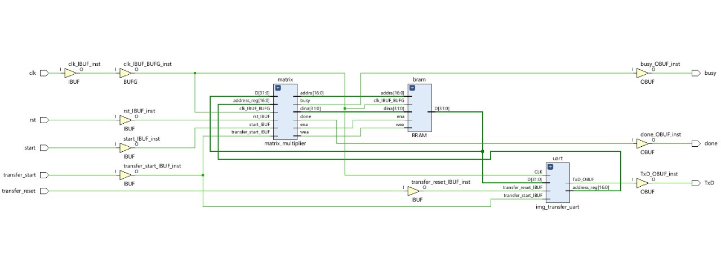
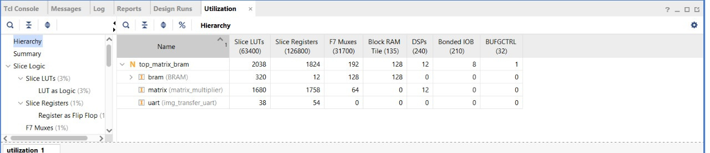
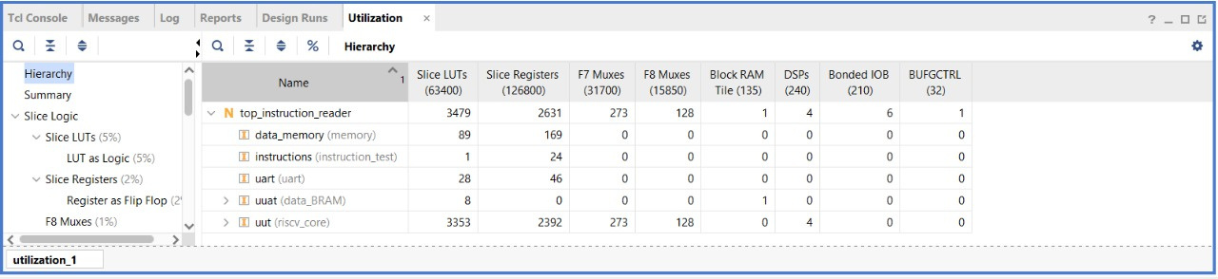
Report

Slide 22


